Slide 1


Slide 2
نحوه برخورد پزشک خانواده با بیمار خانم 52 ساله مبتلا به هپاتیت سی
استاد راهنما:خانم دکتر فنی استادیار و فوق تخصص گوارش بالغین
رزیدنت پزشکی خانواده:دکتر عابدینی

Slide 3
Chief Complaint
خانم 52 ساله با بی اشتهایی و تهوع و ضعف و بی حالی از چند ماه قبل

Slide 4
Present Illness
خانم 52 ساله با علایم گوارشی غیر اختصاصی تهوع و بی اشتهایی از چند ماه قبل و ضعف و بی حالی به کلینیک مراجعه کرده است
خانه دار و با سابقه بیماری هایپرتانسیون بوده و کاهش وزن و استفراغ و زردی را ذکر نمی کرد

Slide 5
PH/E
خانم میانسال ill و توکسیک نبود ظاهر ایکتریک نداشت
BP=12/80 PR=92 RR=16 T=37 BMI=23
در معاینه پوست ضایعه پوستی خاصی نداشت وملتحمهpale و اسکلرا ایکتریک نبود ، سر و گردن لنفادنوپاتی نداشت ،سمع قلب و ریه نرمال بود ،در معاینه شکم نرم و بدون تندرنس بود وهپاتومگالی و اسپلنومگالی نداشت ، شواهدی به نفع آسیت نداشت ،معاینه اندامها نرمال بود،
معاینه نرولوژیک نرمال بود

Slide 6
PMH,DH,HH
سابقه بیماری هایپرتانسیون و مصرف داروی کاپتوپریل دارد.
سابقه جراحی سزارین 2 نوبت دارد.
سابقه تزریق خون ندارد.smoker و Iv drug user نبوده و Opium Addiction نداشته است.
سابقه فامیلی از بیماری های کبدی ندارد.

Slide 7
Lab Test
WBC=5700
Hb=11
PLT=250000
FBS=97
ALT=95
AST=90
ALP=300
BUN=24
Cr=0.9

Slide 8
Bili T=1
Bili D=0.5
TSH =2
ESR =8
CRP = -

Slide 9


Slide 10
HBS Ag= -
HBc Ab (Igm) = -
HCV Ab= +
HAV Ab (Igm) = -
Serum protein electrophoresis , ANA, ASMA ,Anti LKM-1محدوده نرمال
Serum ceruloplasmin = 25
Ferritin = 70

Slide 11
سونوگرافی شکم و لگن:
کبدچرب گرید 1 و پانکراس ،مجاری صفراوی و کیسه صفرا نرمال و بدون ضایعه بود ،طحال با شکل وسایزواکوژنیسیته نرمال بود ،کلیه ها دارای ابعاد طبیعی وبا اکوژنیسیته پارانشیم طبیعی بود و بقیه احشا شکم نرمال بود

Slide 13
Although many patients with chronic HCV infection are symptomatic, most symptoms are nonspecific and not clearly a result of HCV infection itself. Even if cirrhosis develops, many patients have only nonspecific symptoms.
Some patients have extrahepatic findings (such as cryoglobulinemia, renal disease, or specific dermatologic disorders) that are directly related to HCV infection.

Slide 14
Generalized symptoms — Patients with chronic HCV infection often have a high symptom burden, but the extent to which HCV infection itself, rather than comorbid conditions, contributes to the symptoms is unclear.
The most frequent complaints are fatigue and sleep disturbances; other symptoms include nausea, diarrhea, abdominal pain, anorexia, myalgia, arthralgia, weakness, and weight loss . Neuropsychiatric symptoms (eg, depression and anxiety) are also common.

Slide 15
Extrahepatic manifestations
●Hematologic diseases, such as essential mixed cryoglobulinemia and lymphoma
●Renal disease, particularly membranoproliferative glomerulonephritis
●Autoimmune disorders, such as thyroiditis and the presence of autoantibodies
●Dermatologic conditions, such as porphyria cutanea tarda and lichen planus
●Diabetes mellitus

Slide 16
Laboratory findings
Serum aminotransferases —
Up to one-third of patients have a normal serum alanine aminotransferase (ALT) .
Slight enzyme elevations are usually seen in the remaining patients;
only about 25 percent have a serum ALT concentration more than twice normal, and it is rare to find elevations more than 10 times normal.

Slide 17
Other — Other laboratory manifestations that can be observed in chronic HCV infection include those that are related to the potential extrahepatic manifestations of HCV.
As examples, low platelets may reflect immune-mediated thrombocytopenia; a reactive rheumatoid factor, an increased production of autoantibodies; and proteinuria and/or microscopic hematuria, glomerulonephritis.

Slide 18
Risk of chronic infection — The risk of chronic infection after HCV acquisition is high. In most studies, 50 to 85 percent of patients chronically remain HCV RNA positive following infection and seroconversion, depending on the population and the source of infection .
Of those who are able to spontaneously clear HCV, most do so within 12 weeks of seroconversion, although spontaneous clearance after a longer period of follow-up has been described .

Slide 19
The mechanism responsible for the high prevalence of viral persistence, and thus chronic infection, is unclear, but both viral and host factors are likely to contribute.
Viral predictors of risk — HCV has a tendency toward rapid mutation, which leads to extensive viral diversity among the viral populations infecting a single host. This can contribute to viral persistence, as the viral diversity allows HCV to escape immune recognition .

Slide 20
Host predictors of risk — Host factors may also be involved in the ability to spontaneously clear the virus. One of the most influential factors appears to be certain polymorphisms of a chromosomal locus close to the interleukin-28B (IL28B) gene .

Slide 21
NATURAL HISTORY
The majority of patients who acquire HCV do not spontaneously clear the virus and thus develop chronic HCV infection. Chronic infection results in liver fibrosis and ultimately cirrhosis in a subset of patients, although the rate of disease progression is variable.
Patients who develop cirrhosis are at further risk for complicating events (such as variceal hemorrhage, ascites, and encephalopathy) and hepatocellular carcinoma, although many patients with compensated cirrhosis remain stable for years .

Slide 22
Host factors that appear to be adversely associated with fibrosis progression in individual HCV-infected patients are older age, male sex, non-Black race, alcohol use, and comorbidities such as obesity or viral coinfection.
The impact of viral factors (such as genotype or diversity) is less evident.

Slide 23
Host factors
Demographic features — Various demographic features have been associated with disease progression in observational studies of individuals with chronic HCV:
●Sex – Male sex has been associated with faster fibrosis progression . Among women, menopausal and post-menopausal statuses have been associated with fibrosis progression .
●Age – Acquisition of HCV after age 40 to 55 may be associated with a more rapid progression of liver injury. In contrast, infected children appear to have a relatively decreased risk of disease progression .
●Race/ethnicity – Progression may be slower and histology less severe in Black individuals compared with those of other races . In addition, certain complications of liver disease, particularly hepatocellular carcinoma, are more common in Japan than in the United States ;

Slide 24
Route of HCV acquisition – Patients who acquire the disease from a blood transfusion may be at increased risk for disease progression compared with those infected via other modes . However, this relationship has not been confirmed in all studies.
Comorbidities — Certain comorbidities have been implicated in progression of liver disease in the setting of chronic HCV infection:
●HIV infection – Patients co-infected with HIV and HCV have an accelerated rate of progression to cirrhosis.
●HBV infection – Liver disease is typically more severe in patients with active HBV and HCV coinfection than either infection alone.

Slide 25
Diabetes mellitus and insulin resistance – Several studies have demonstrated a greater risk of fibrosis progression and cirrhosis in patients with diabetes mellitus and insulin resistance
This association may be due, in part, to the risk of hepatic steatosis in such patients, which is itself associated with fibrosis progression
Among HCV-infected patients who have cirrhosis associated with chronic HCV infection, diabetes mellitus has also been associated with complications such as encephalopathy, bacterial infection, and hepatocellular carcinoma .
●Obesity – Patients who have a high body mass index and hepatic steatosis are at increased risk for the development of fibrosis .
●Vitamin D deficiency – In a meta-analysis of seven studies, a vitamin D level <10 ng/mL was associated with advanced fibrosis .

Slide 26
Behavioral factors — Behavioral factors have also been associated with the rate of disease progression:
●Alcohol use has a major negative impact on disease progression.
●Regular coffee consumption has been associated with a lower rate of disease progression, reduced hepatic fibrosis, and lower risk of hepatocellular carcinoma.
●Daily use of marijuana has been associated with the development of hepatic steatosis and more rapid fibrosis progression, possibly through stimulation of endogenous, hepatic cannabinoid receptors .
●Higher levels of dietary cholesterol consumption have been associated with an increased risk of clinical and histologic progression of liver disease . In contrast, statin use has been associated with lower fibrosis progression rate and decreased risk of progression to cirrhosis and hepatic decompensation .

Slide 27
Alcohol intake — Heavy alcohol use has been associated with progression of liver disease in patients with chronic HCV infection.
. Alcohol use is also associated with hepatocellular carcinoma and increased mortality in HCV-infected patients . Thus, alcohol intake should be avoided in all patients with chronic HCV infection.

Slide 29
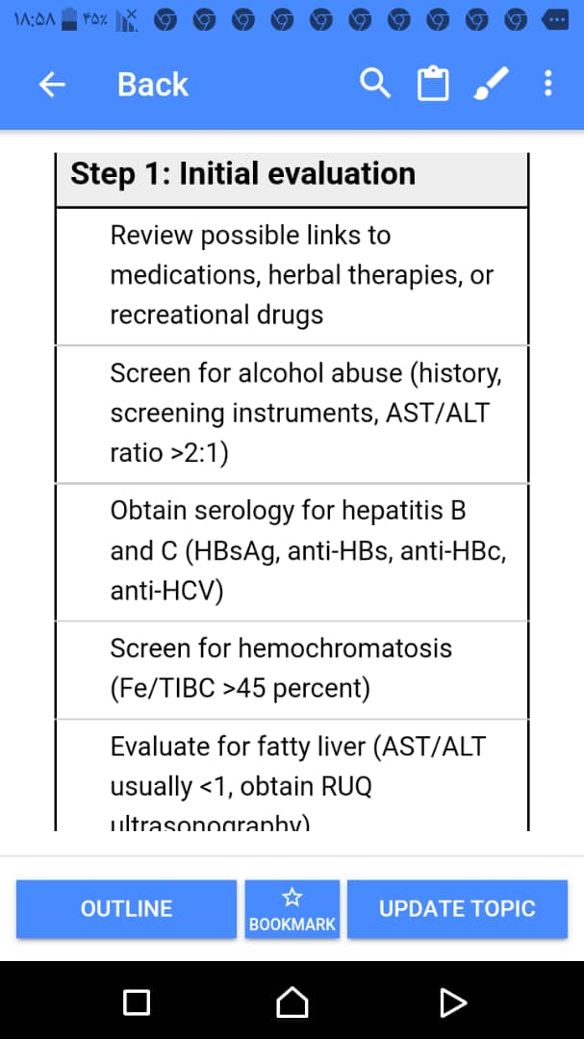

Slide 30
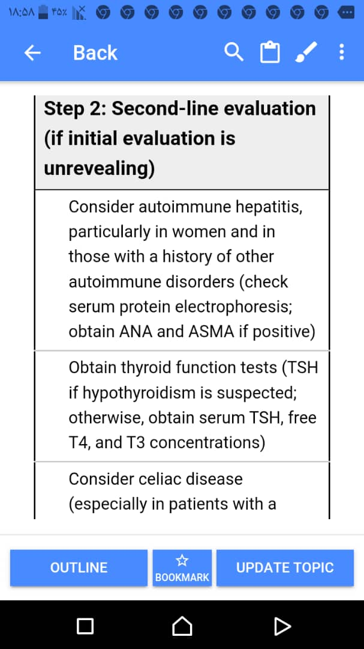

Slide 31
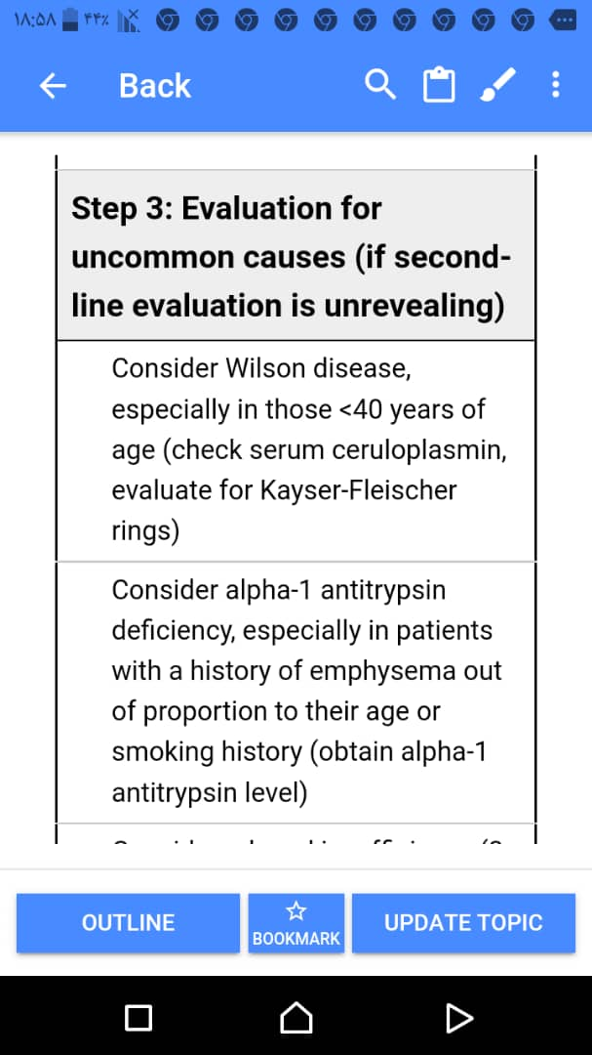

Slide 32
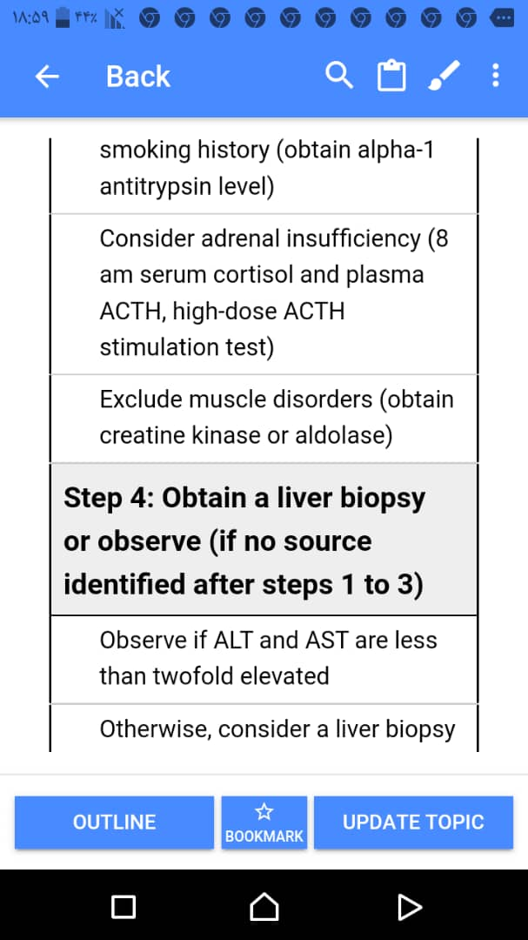

Slide 33
Findings in cirrhosis — Approximately 5 to 30 percent of chronically infected individuals develop cirrhosis over a 20- to 30-year period of time
The development of cirrhosis is silent in the majority of patients in whom it occurs . Although these patients tend to be more symptomatic than those with chronic hepatitis alone, no clinical symptom, physical sign, or laboratory test is either sensitive or very specific for the diagnosis. The physical examination may reveal hepatomegaly (68 percent in one series) or splenomegaly .
Laboratory testing can be helpful in identifying cirrhosis in HCV-infected patients, but none are 100 percent specific. Suggestive findings include an elevation in the serum bilirubin concentration, hypoalbuminemia, or a decrease in the platelet count .

Slide 34


Slide 35
Patient Education
●Avoid alcohol
●Maintain a healthy weight
●Get vaccinated for hepatitis A and B
●Get vaccinated for pneumonia, the flu, COVID-19, and other diseases
●Ask your doctor or nurse before taking any over-the-counter pain medicines
About 1 in 20 pregnant people who have hepatitis C pass the virus on to their baby during pregnancy. This number is higher in people who are also infected with HIV.

Slide 36
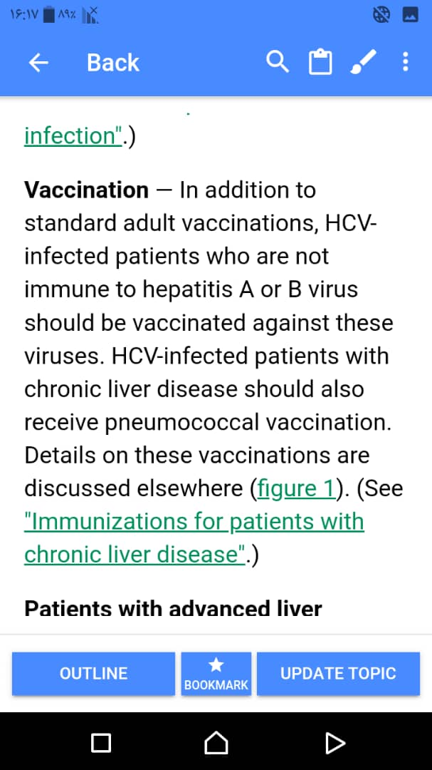

Slide 37
Transmission Of Hepatitis-C
●Sharing needles, syringes, or other paraphernalia used for injection drug use
●Receiving a blood transfusion before 1990, when blood was not routinely tested for hepatitis C or other infections
●Having sex with an infected person
It is also possible to get the hepatitis C virus by:
●Getting body piercings or tattoos done with improperly sanitized equipment
●Sharing straws used for snorting cocaine
●Sharing toothbrushes, razors, or other things that could have blood on them
●Getting stuck with a sharp object that has contaminated blood on it (as might happen in a health care setting)
Pregnant women have about a 5 percent chance of passing the virus on to the developing baby.

Slide 38
There is no evidence that any of the following activities lead to transmission of hepatitis C:
●Kissing or hugging
●Sneezing or coughing
●Casual contact or other contact that does not involve blood
●Sharing food, water, eating utensils, or drinking glasses

Slide 39
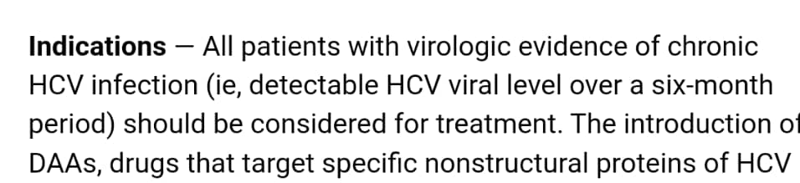

Slide 40


Slide 41


Slide 42


Slide 43


Slide 44
سطوح پیشگیری
Primordial Prevention
Primary Prevention
Secondary Prevention
Tertiary Prevention
Quaternary Prevention

Slide 45
Primordial Prevention
1- افزایش آگاهی عمومی مردم ،جوانان و خانواده ها در خصوص بیماری هپاتیت و راههای انتقال آن از طریق رسانه ها
2- تولید برنامه های آموزشی در این خصوص و ارایه این برنامه ها در مدارس برای آگاهی دانش آموزان و خانواده ها
3- ترانسفیوژن خون با شرایط استاندارد
4- ایجاد فضاها و مکان های ورزشی ،تفریحی جهت ایجاد سرگرمی های سالم برای خانواده ها و جوانان و تشویق آنها برای زندگی سالم

Slide 46
Primary Prevention
1- آموزش جوانانی که در ریسک خطر ابتلا به مواد مخدر و الکل وهپاتیت سی هستند
2- آموزش به خانواده های دانش آموزان و خانواده هایی که در ریسک ابتلا هستند
3- توصیه به عدم استفاده از سرنگ مشترک در معتادین
4- توصیه به تغذیه سالم وانجام فعالیتهای ورزشی و تفریحی برای جوانان و خانواده ها
5-آموزش خانواده ها از طریق مراکز فرهنگی و انجمن اولیا مربیان مدارس در خصوص مسایل تربیتی وبهداشت جنسی دانش آموزان و جوانان

Slide 47
Secondary Prevention
1- غربالگری خانواده های بیماران مبتلا به هپاتیت جهت آموزش راههای انتقال ویروس
2- غربالگری و واکسیناسیون بیماران مبتلا علیه هپاتیت A و B و آنفلوآنزا و کووید
3- غربالگری و تشویق برای ترک سیگار و الکل و مواد مخدرومشاوره رفتاری در خصوص روابط جنسی ناسالم

Slide 48
Tertiary Prevention
1- درمان مناسب دارویی بیماران بر اساس وضعیت بیمار
2- ارجاع به سطح بالاتر تشخیصی ودرمانی و انجام فالوآپ مناسب با شرایط پزشکی هر بیمار

Slide 49
Quaternary Prevention
1- عدم استفاده از داروی نامناسب و یا بررسی های غیر ضروری تشخیصی و تصویربرداری
2- اطمینان بخشی به بیمار و خانواده های آنان در مورد عدم انتقال ویروس از راه تماسهای معمولی

